Slide 1
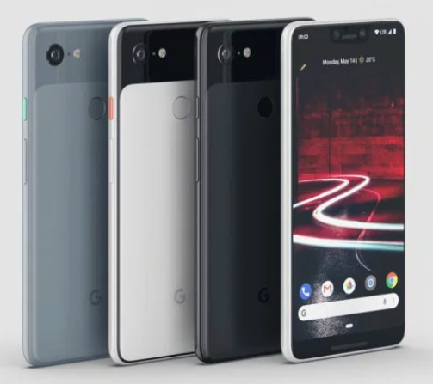

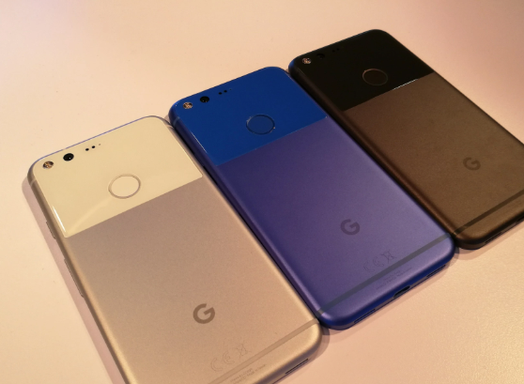
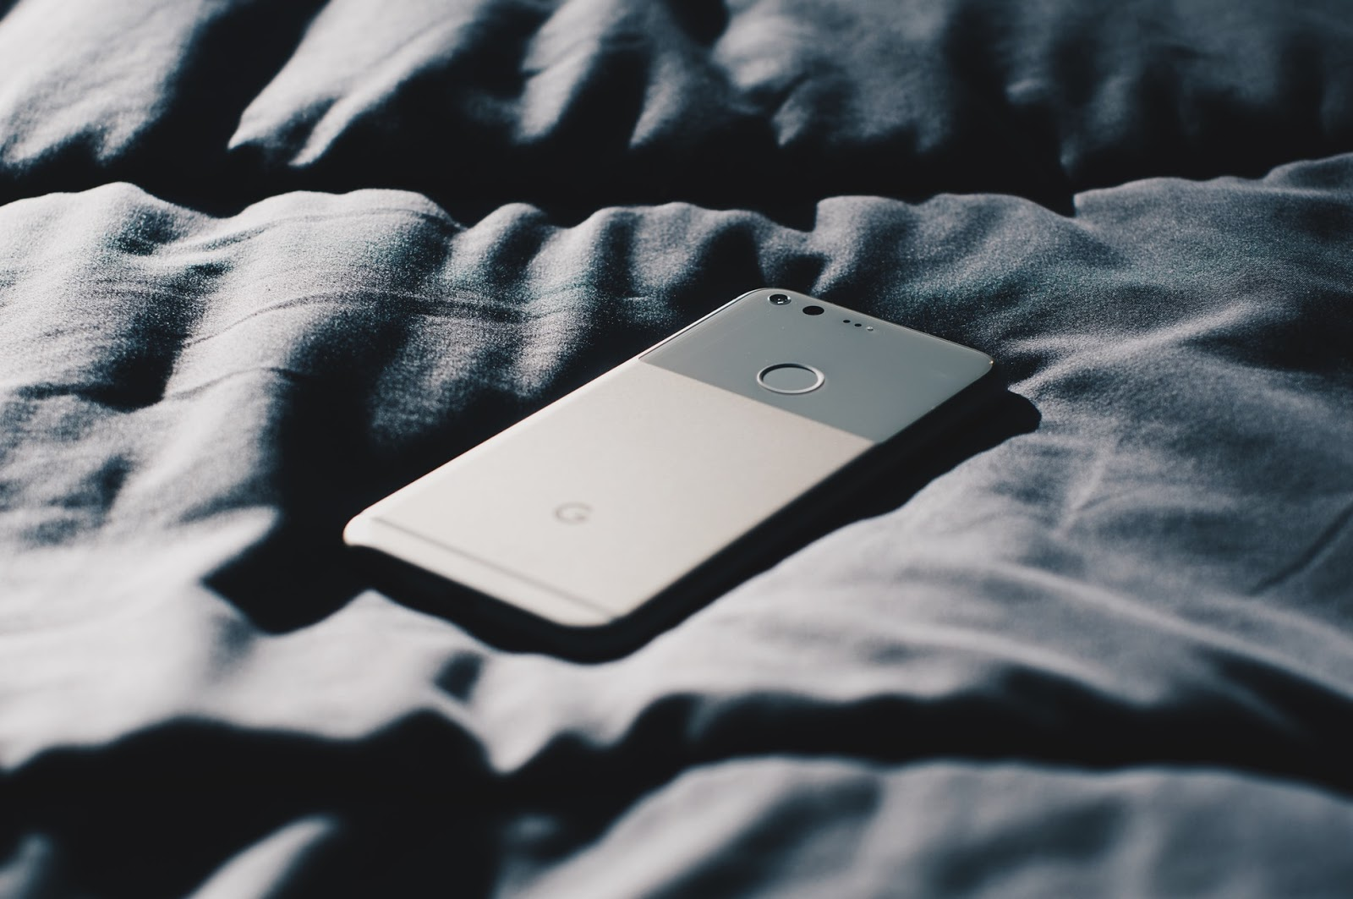



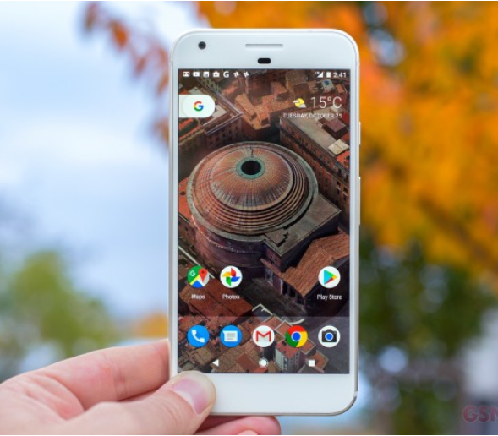

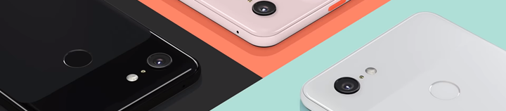
Real Time Tweets Sentiment Dashboard for leading Smartphone Brands
Group 6
Rohan Bhatia
Henry Feng
Hua Lang
Ankur Tomar
Samridhi Wadhwa
Tanmayee Waghmare

Slide 2
How Twitter can increase business prospects
335M+ monthly users
500M+ tweets everyday
80% tweets talk about a brand
Source: Statistics of Twitter

Slide 3
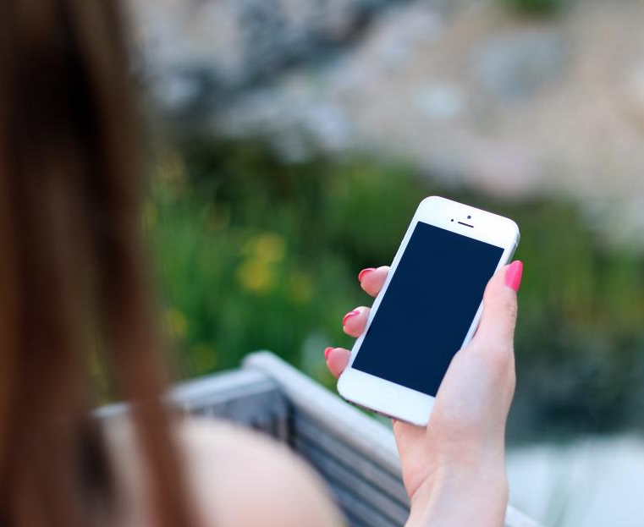
Business Motivation
Why we chose
Mobile Industry?

Slide 4
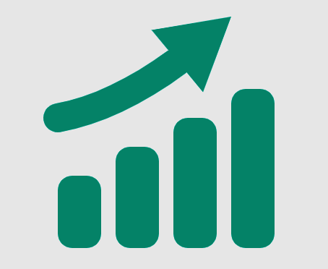

68%
355B
US population use a smartphone
6B
Smartphones will be sold in 2020
Size of current smartphone market
Source: Statistics of SmartPhone Industry

Slide 5
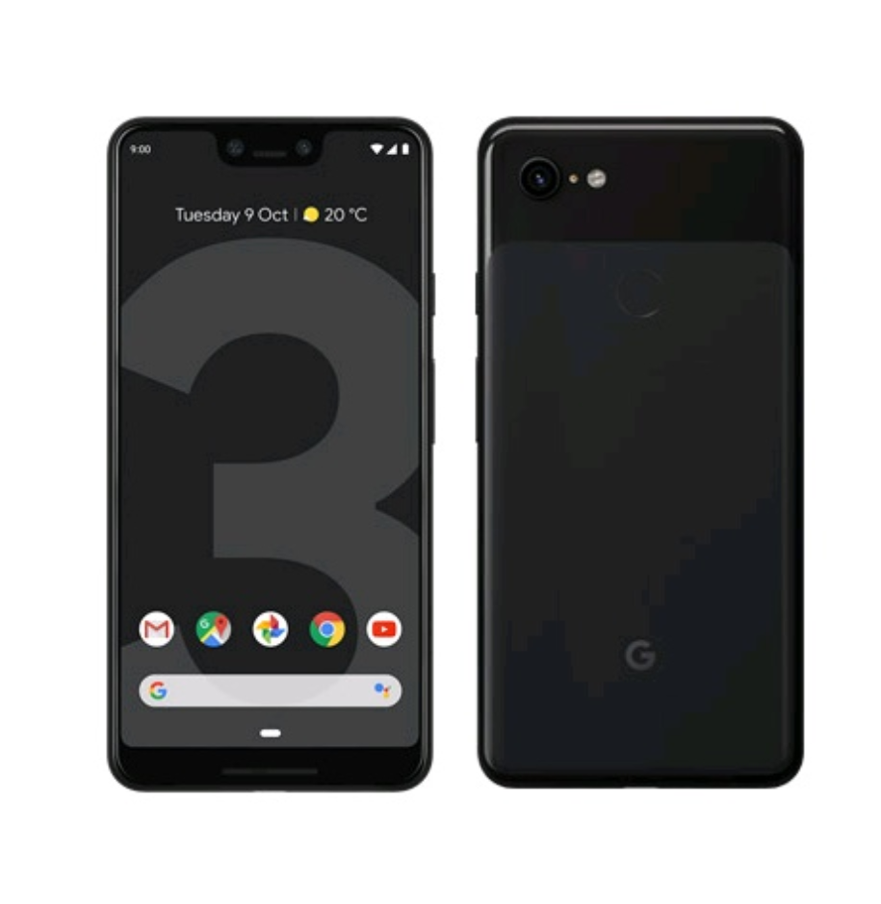
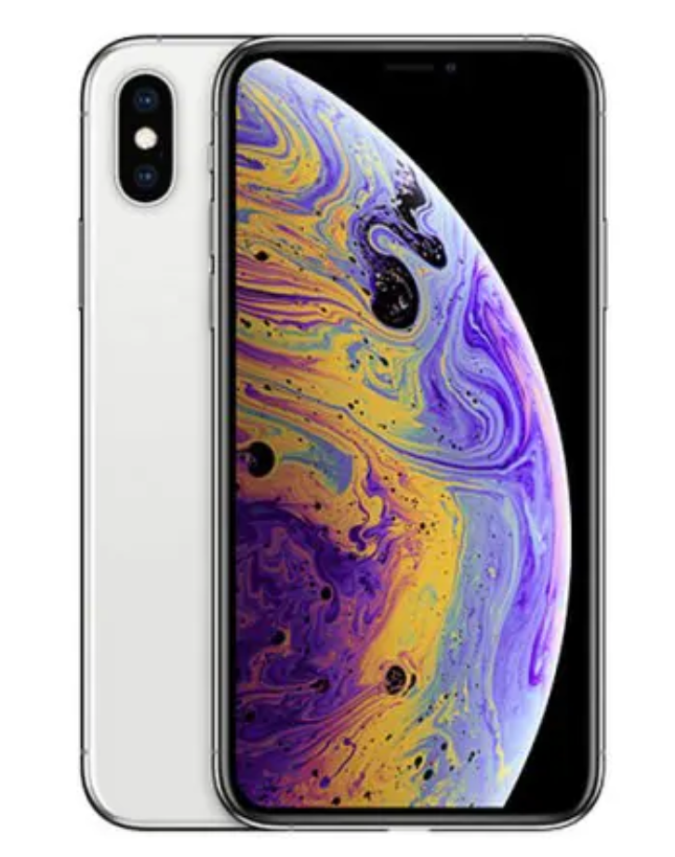
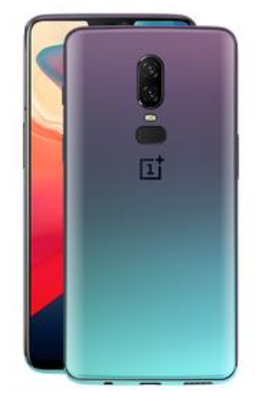
2018 saw launch of…
iPhone Xs
Google Pixel 3
OnePlus 6
September
2018
October
2018
November
2018

Slide 6


Lets finds out what twitteratti has to say…

Slide 7

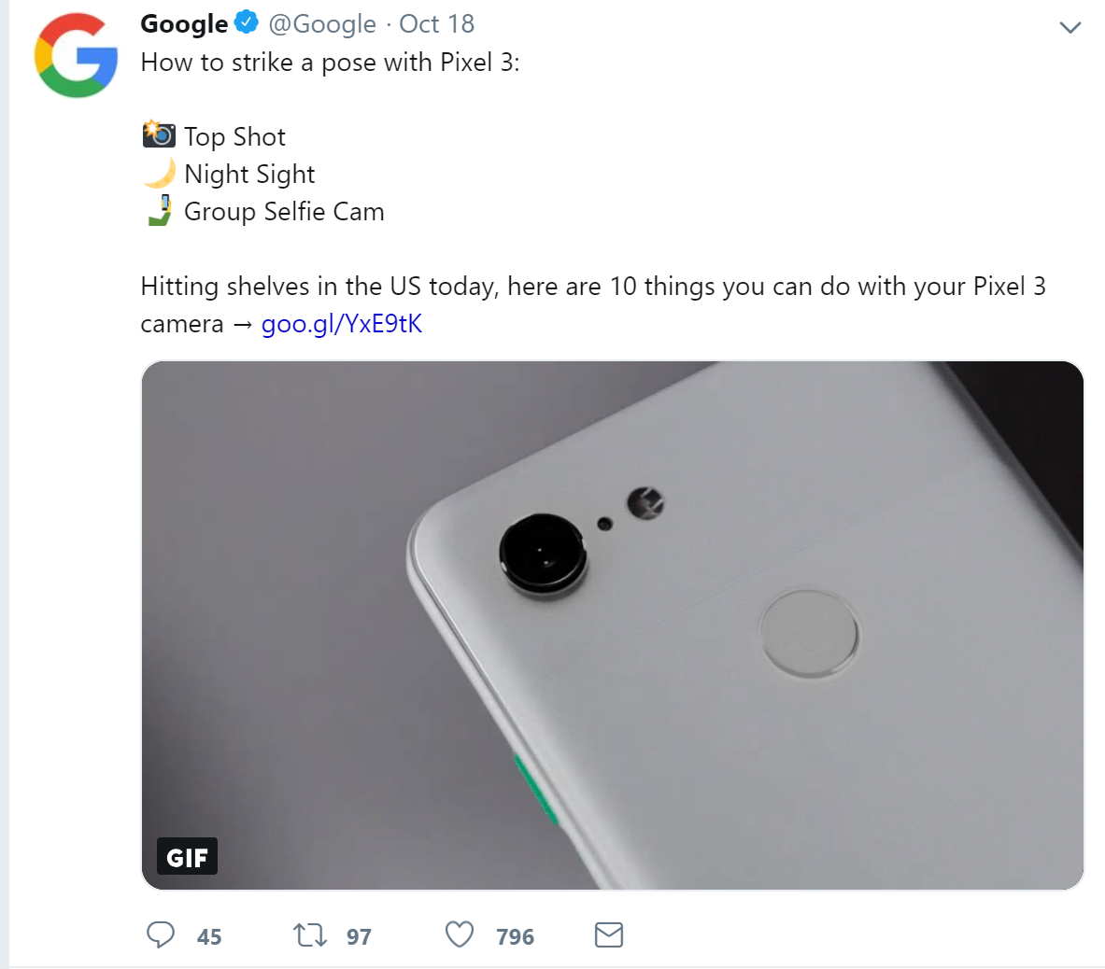
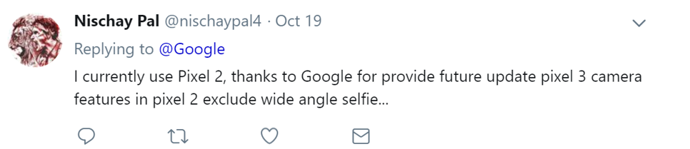
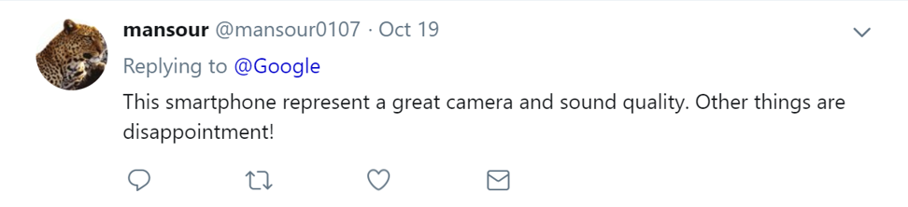
Tweets for Google Pixel
Source: https://twitter.com/

Slide 8

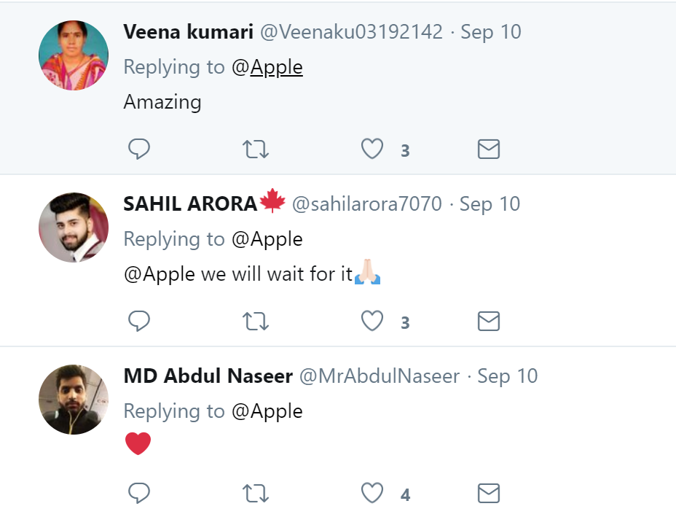
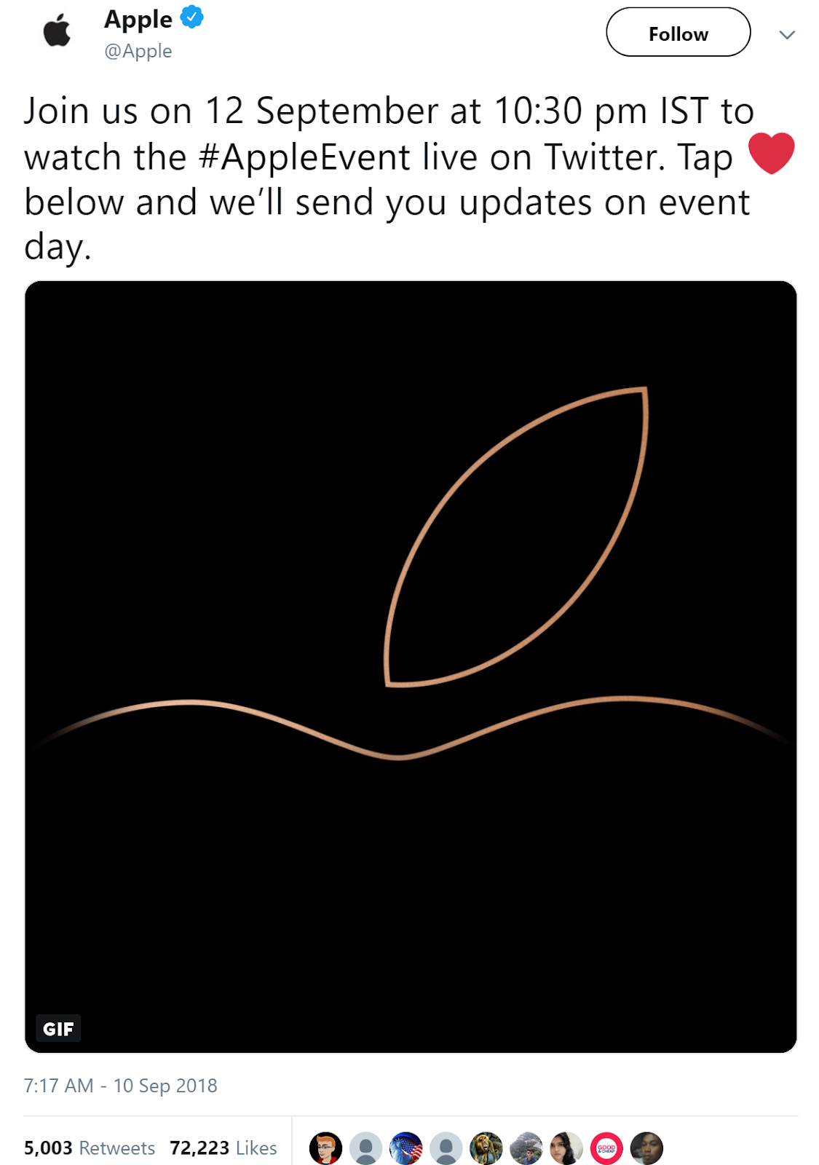
Tweets for iPhone Xs
Source: https://twitter.com/

Slide 9

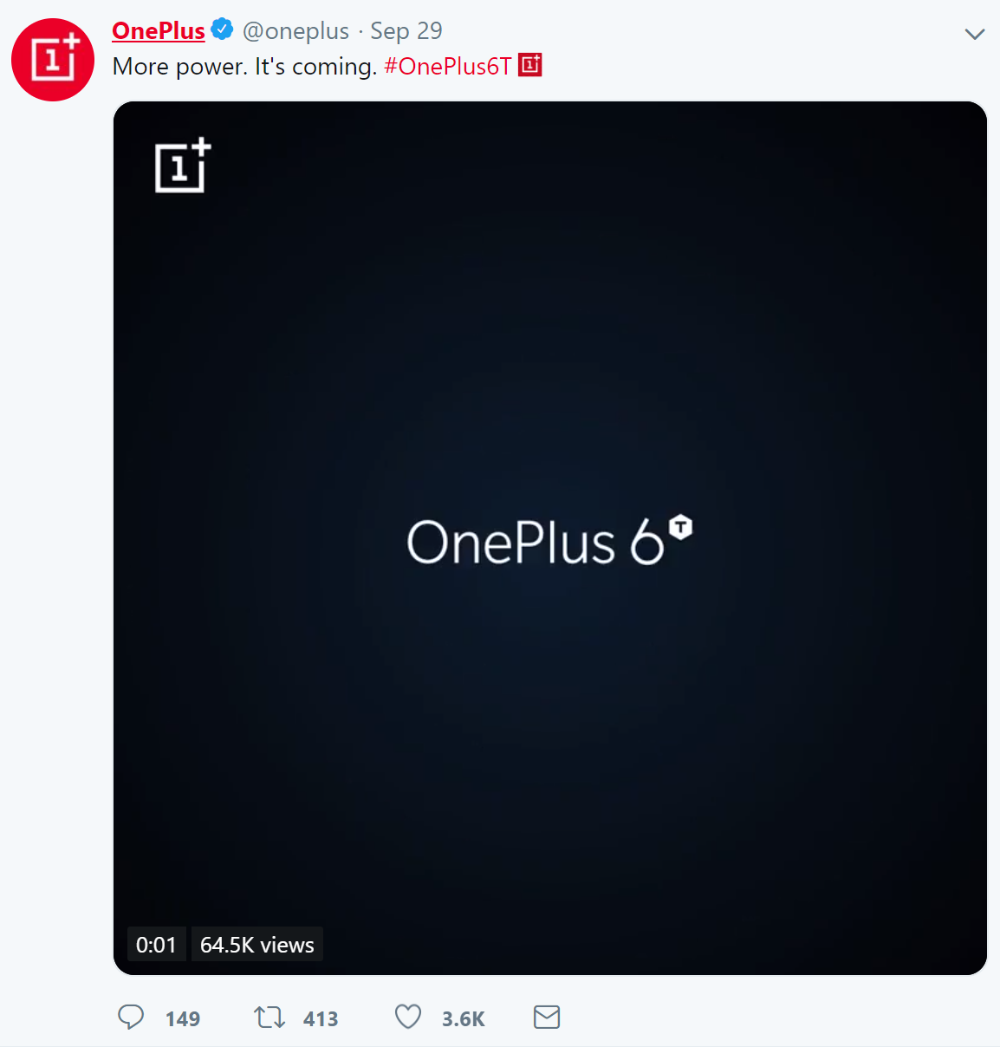
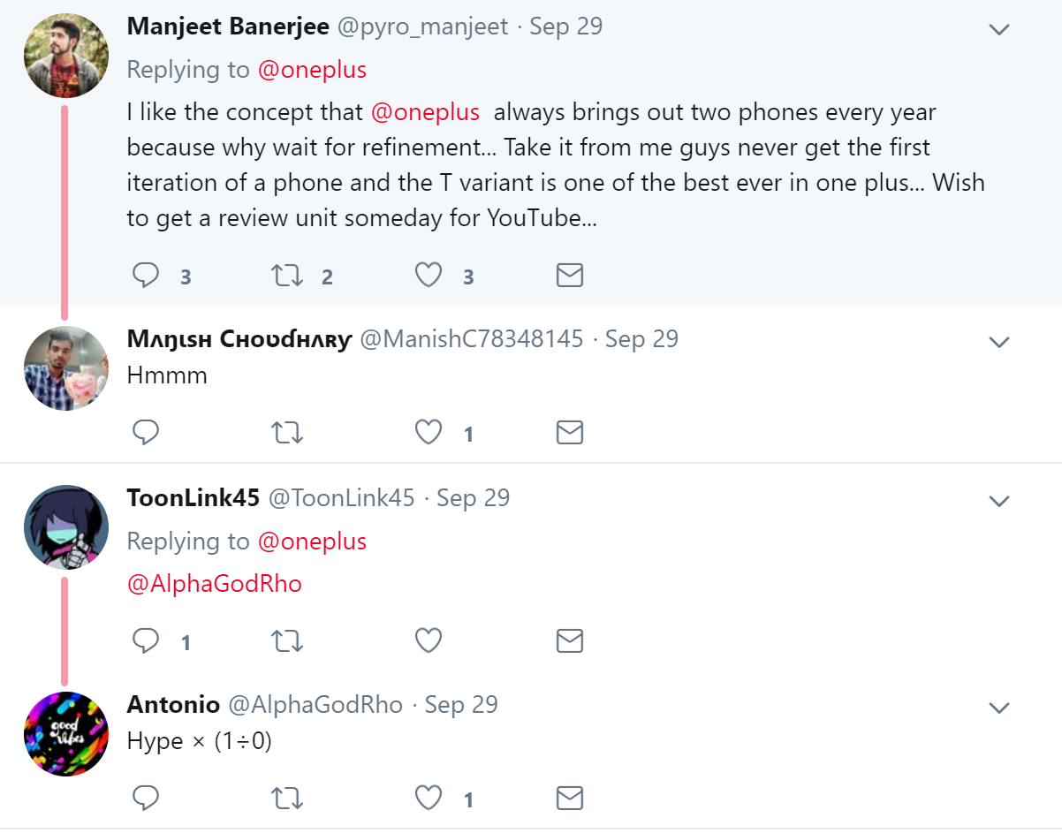
Tweets for OnePlus
Source: https://twitter.com/

Slide 10
Benefits of
Sentiment Analysis

Slide 11


Gauge buyer’s response to new product launches
Improve customer satisfaction
Track customer engagement with competitor products

Slide 12

Why AWS ?
Real Time Streaming & Monitoring
Scalability
Robustness
Interpretable

Slide 13
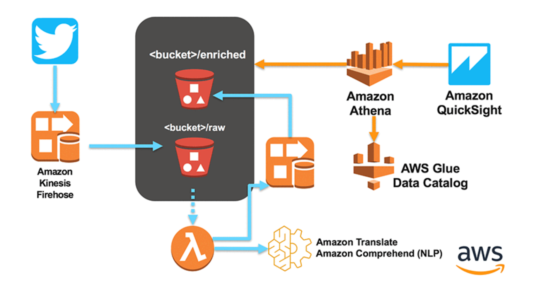
AWS process flow

Slide 14

AWS toolkit
Amazon Kinesis Data Firehose
AWS Lambda
Amazon Athena
Amazon QuickSight
Captures and loads real-time tweets. Raw tweets stored in S3
Combines Amazon Translate and Amazon Comprehend to perform NLP on Tweets
Queries data stored in Athena tables similar to SQL querying
Builds dashboard using the data queried

Slide 15


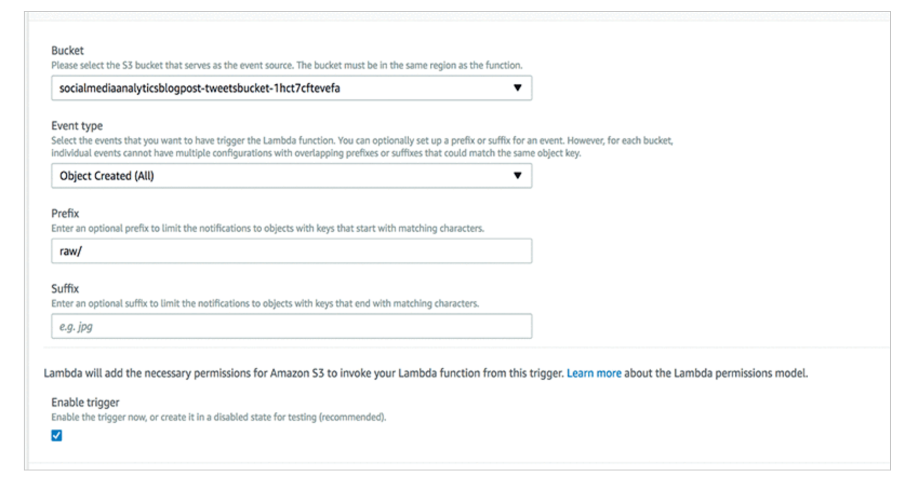
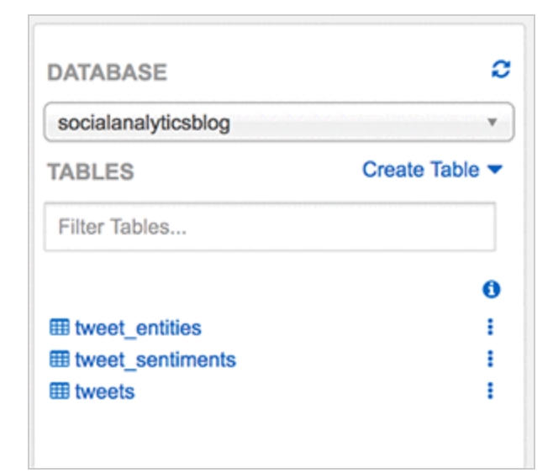
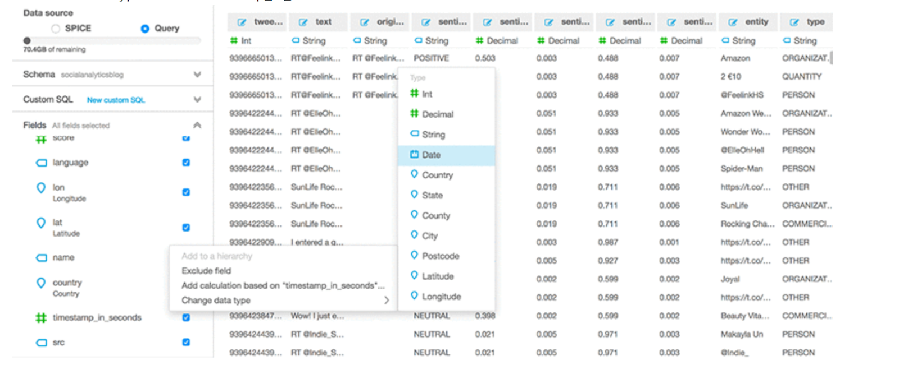
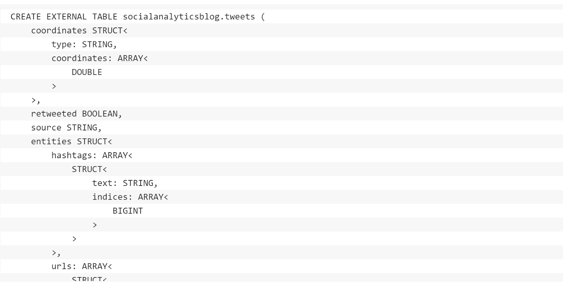


Process explained…
Amazon S3 Bucket
Amazon
Lambda
Amazon Athena
Amazon Quicksight

Slide 16
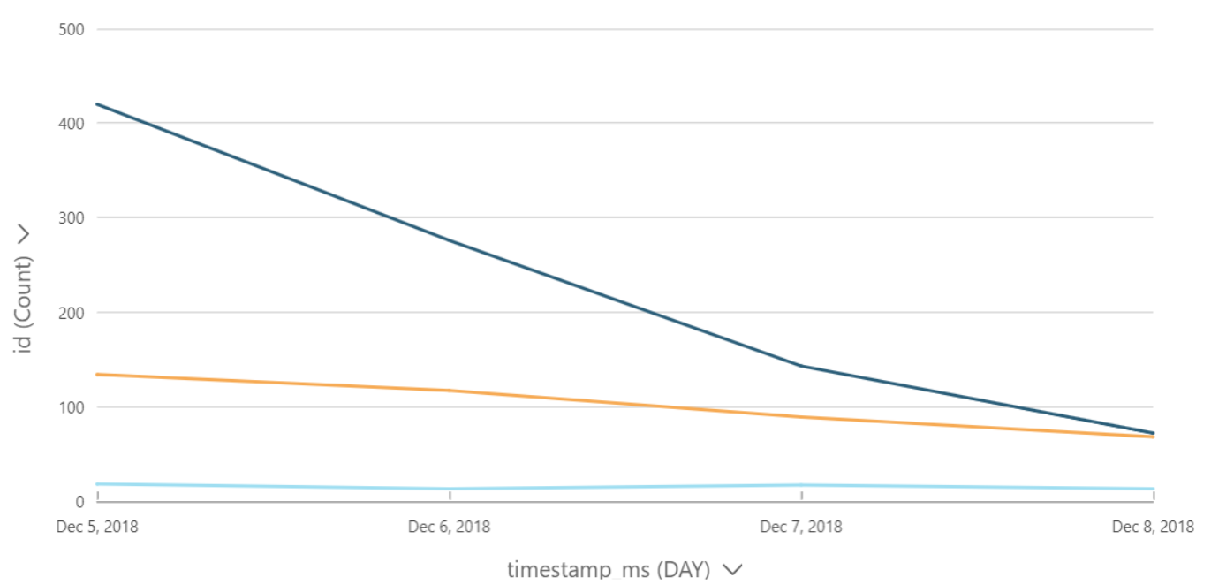
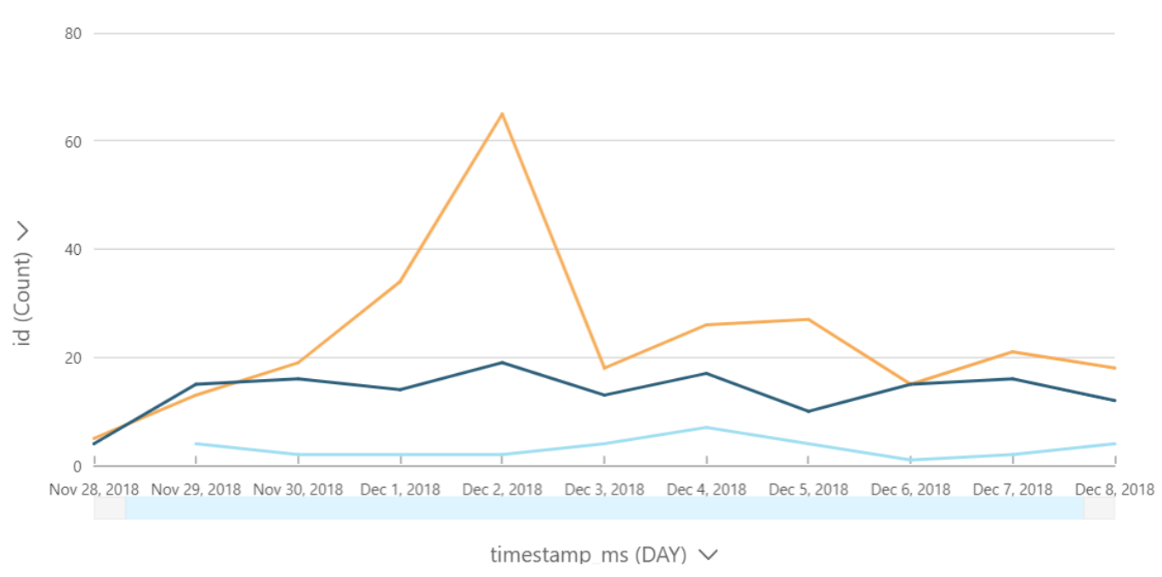
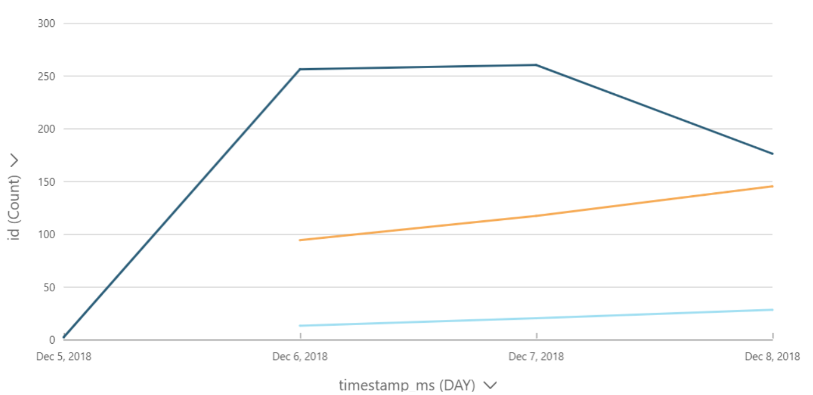
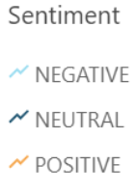
Dashboard – Daily count of tweets across sentiment
Google Pixel 3
OnePlus 6
iPhone Xs

Slide 17

Sentiment Decoded!

Slide 18


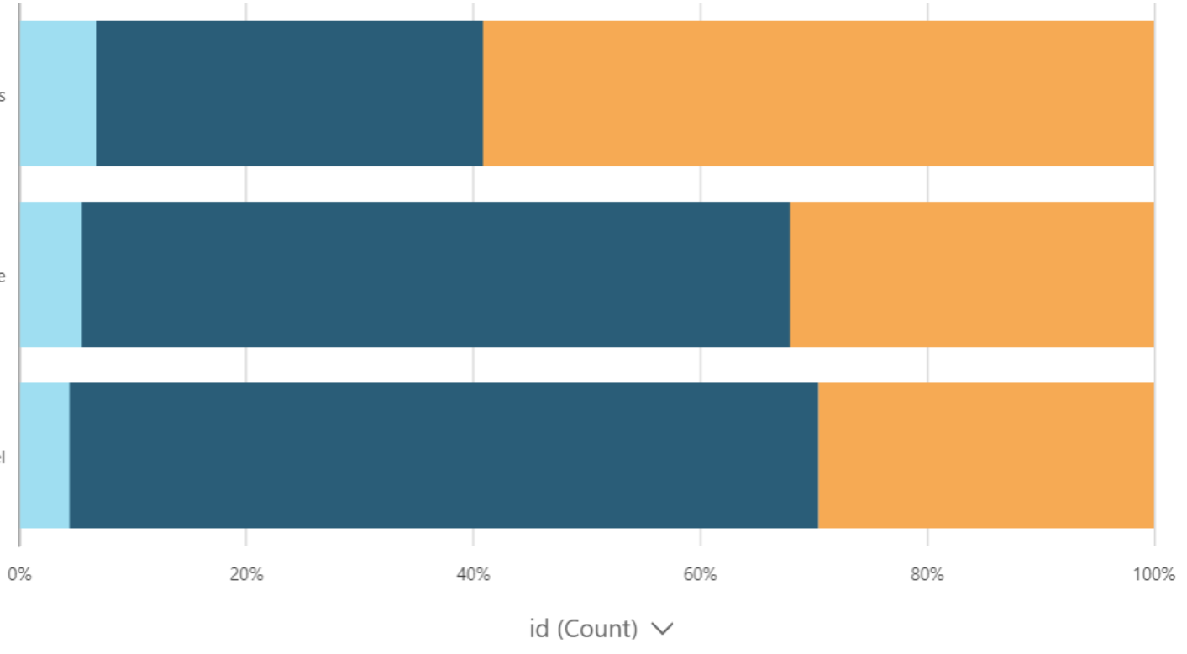
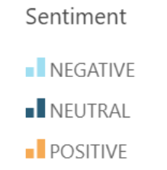
Percentage distribution across sentiment
OnePlus 6
iPhone Xs
Google Pixel 3

Slide 19
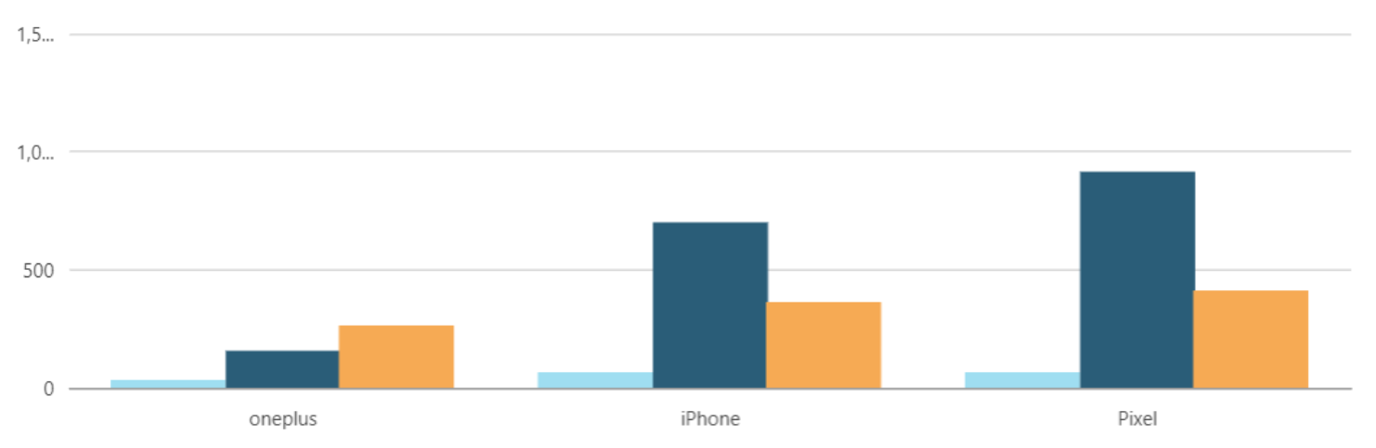
Count of tweets across brands
1500
1000
500
0
0
OnePlus 6
iPhone Xs
Google Pixel 3

Slide 20
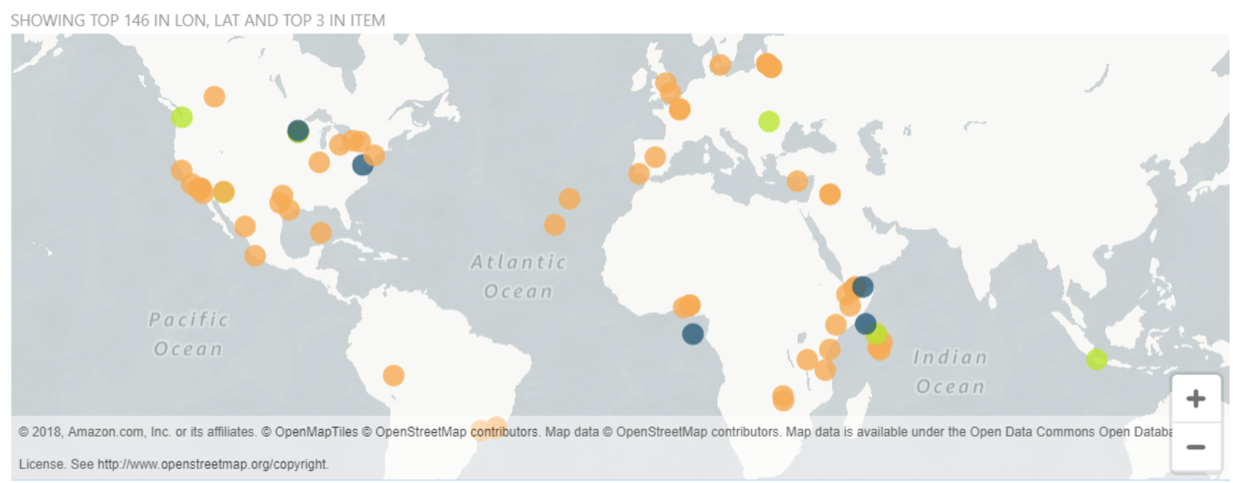
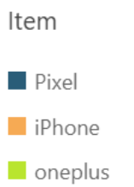
Tweets by location and brand
0

Slide 21
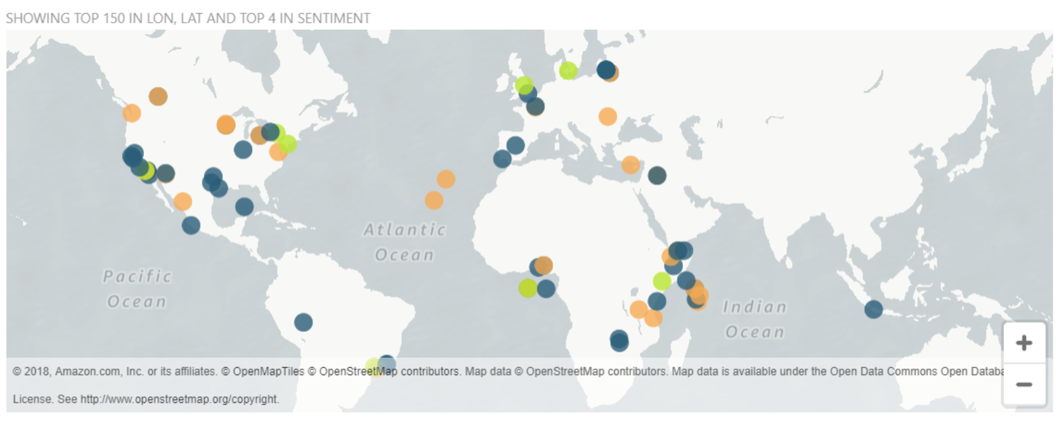
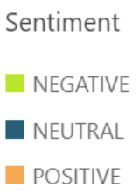
Tweets by location and brand

Slide 22
Other
Business Use Cases

Slide 23


Used similar-looking posts – one with white background and another with black background.
Monitored customer tweets on social media (including Tweets)
Chose the post with the most positive sentiment
Boosted ROI on the ads
Source: Social Media Sentiment Business Use Cases

Slide 24
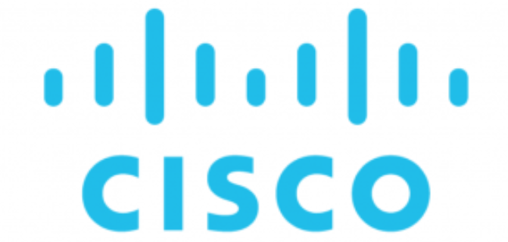
Exercised social listening as a Sponsor for summer Olympics and Annual trade show – Cisco Live
Achieved 281% ROI through social listening
Source: Social Media Sentiment Business Use Cases

Slide 25
Thanks!
Any questions?

